Slide 1
House Pricing Models

Slide 2
Problem
The primary problem we are addressing is predicting house prices based on property features. The goal is to develop a model that provides accurate price estimates, helping stakeholders in the real estate market.

Slide 3
Methodology
High-Level Description: We use machine learning techniques to build a predictive model for house prices. The process involves data preprocessing, model selection, training, and evaluation.
Model Types: Random Forest Regressor, Decision Tree Regressor, Linear Regression

Slide 4
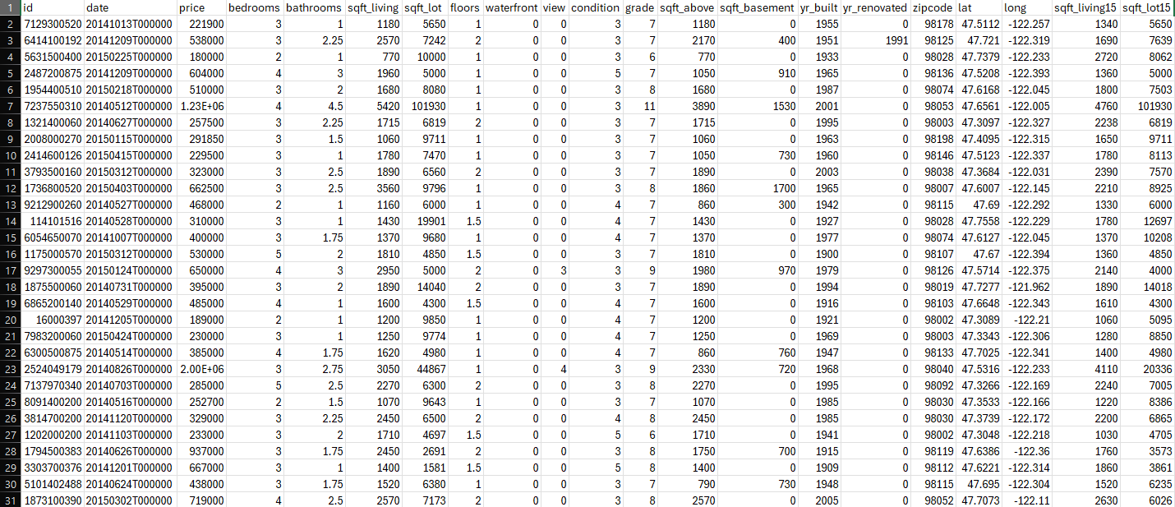
Dataset Description
Programming Language: Python
Libraries: Scikit-learn, Pandas, NumPy, Matplotlib, Seaborn
Model Types: Random Forest Regressor, Decision Tree Regressor, Linear Regression

Slide 5
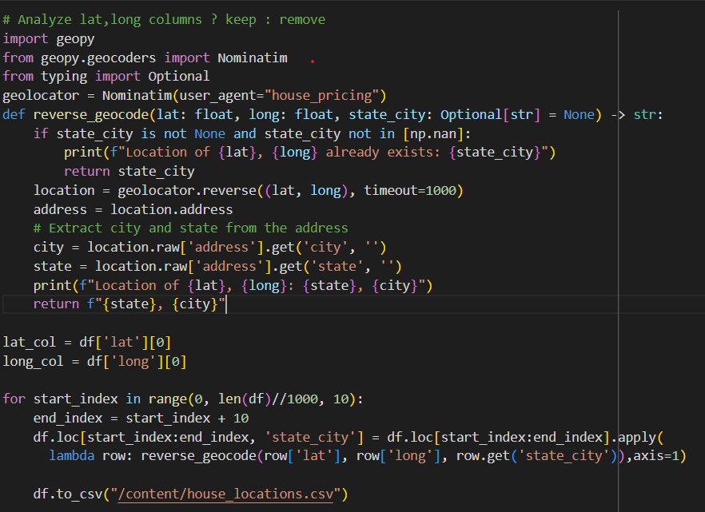
Pre-Processing
Find each house location :
Process :
Drop unnecessary features – date, zipcode, id
Find each house location by its lat, long values using geopy library.
All houses are in Washington– location is unnecessary feature - drop

Slide 6
Target Class -> Price
We used the following models to predict the price:
Random Forest Classifier
ID3
Linear Regressor
Process :
Split the DataSet to train, test
Init, train, and predict each model
Model | Accuracy Score | Over-Fitting
Random Forest Classifier | 0.9211195928753181 | No ☺
ID3 | 0.8924358084663429 | Yes (0.107)
Linear Regressor | R² = 0.6534026663127288 MSE = 59823036364.11011 | - - -

Slide 7
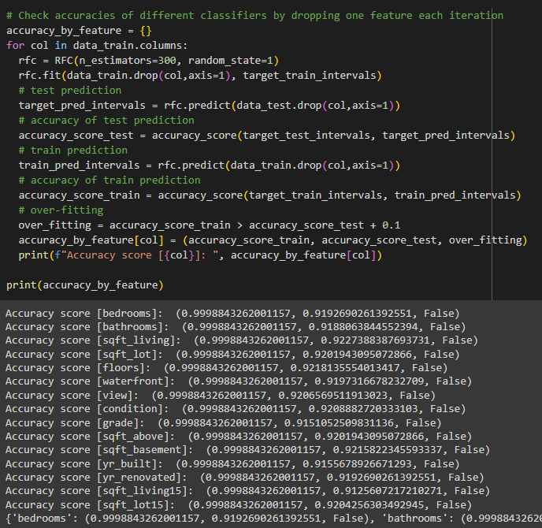
Target Class -> Price
Find best RFC by dropping a feature from the DF each Iteration :
We discovered that none of the features has significant influence on the model’s prediction skills.

Slide 8
Target Class -> Bedrooms
Model | Accuracy Score | Over-Fitting
Random Forest Regressor | R² = 0.5175256066967985 MSE = 0.40103919407818645 | - - -
ID3 | 0.7362942401110341 | Yes (0.263)
Linear Regressor | R² = 0.31818225710200665 MSE = 0.566736062919269 | - - -
Bayesian Classifier | 0.44332467532467534 | - - -
We used the following models to predict the price:
Random Forest Regressor
ID3
Linear Regressor
Bayesian Classifier
Process :
Split the Dataset to train, test
Init, train, and predict each model

Slide 9
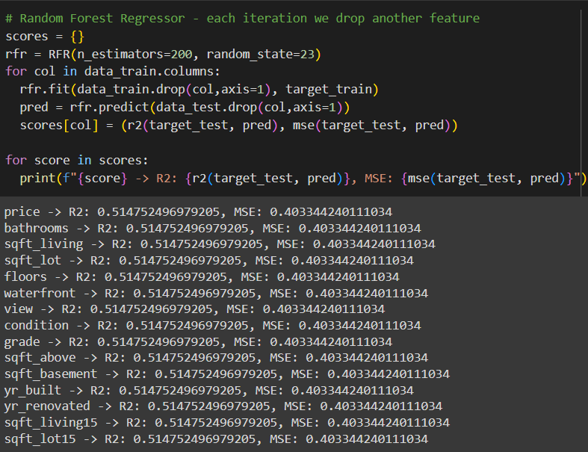
Target Class -> Bedrooms
Find best RFR by dropping different feature each iteration:

Slide 10
Thank you
Ehud Vaknin
Moshe Bercovich

